Slide 1

Title: An Analysis on
House Sale Price
The code can be found at my github acc : github.com/AthirahZulkafli

Slide 2
What is SalePrice?
‘SalePrice’ represent the price of house on sale.
Objective: 1) to predict the Sale Price of house in Test dataset using Train dataset
2) To compare the accuracy (R squared) of our predictive modelling

Slide 3


$ 163 000.00
Median of Sale Price
Min $34,900.00
Max $755,000.00

Slide 4


Data Exploration
Data type
1,460 x 81
Entries Features
(row) (columns)
Others:
53.09%
object
6965 missing values in train dataset
There is no duplicate entries
3.70%
float64
43.21%
int64

Slide 5
Data Cleaning

Slide 6
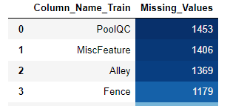
drop unnecessary feature/s
Delete feature that has more than 1000 missing values
Delete unique feature

Slide 7
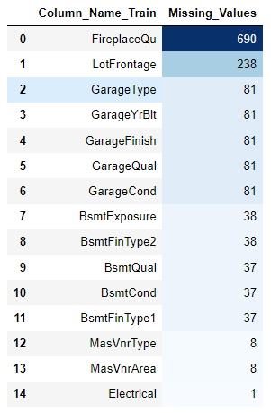
‘NA”
median
treat missing values
Replace with mean if data is normal (numerical features)
Replace with median if data is skewed (numerical features)
Replace with mode for categorical features
Create new class ‘NA” (Not Available)
median
‘NA”
‘NA”
‘NA”
median
mode

Slide 8
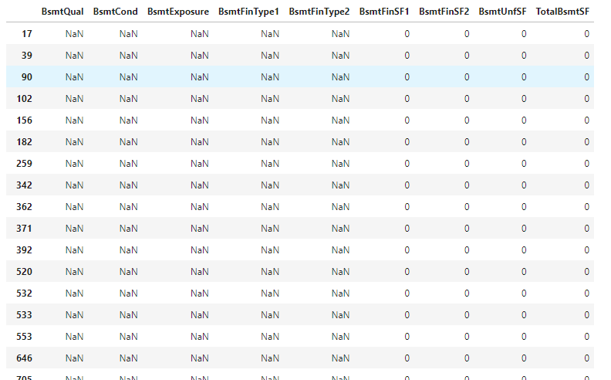

Slide 9
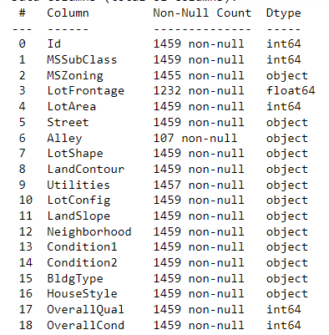
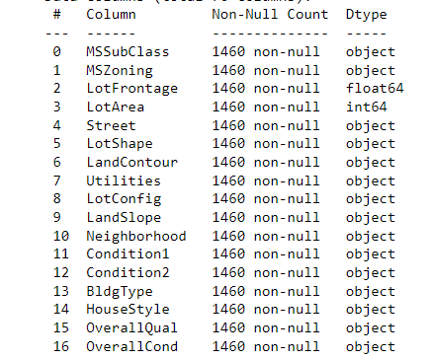

change datatype of MSSubClass, OverallQual and OverallCond to object, since they are categorical features

Slide 10
Before data cleansing
Data type
1,460 x 81
Entries Features
Others:
53.09%
object
6965 missing values in train dataset
There is no duplicate entries
3.70%
float64
43.21%
int64

Slide 11
After data cleansing
Data type
1,460 x 76
Entries Features
Others:
55.26%
object
0 missing values in train and test dataset
There is no duplicate entries
3.95%
float64
40.79%
int64

Slide 12
EDA
Discrete
Numerical
Year
Continuous
Categorical
Non-Year

Slide 13
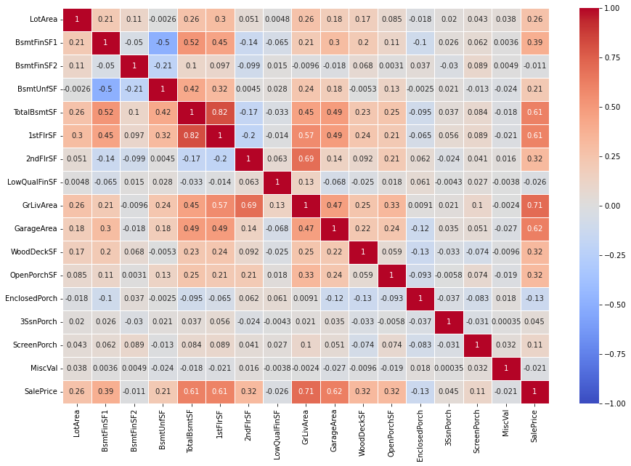
Correlation between the continuous features
A perfect positivecorrelation
A perfect negative correlation
'TotalBsmtSF’, '1stFlrSF’, 'GrLivArea’, 'GarageArea’ has the highest positive correlation

Slide 14
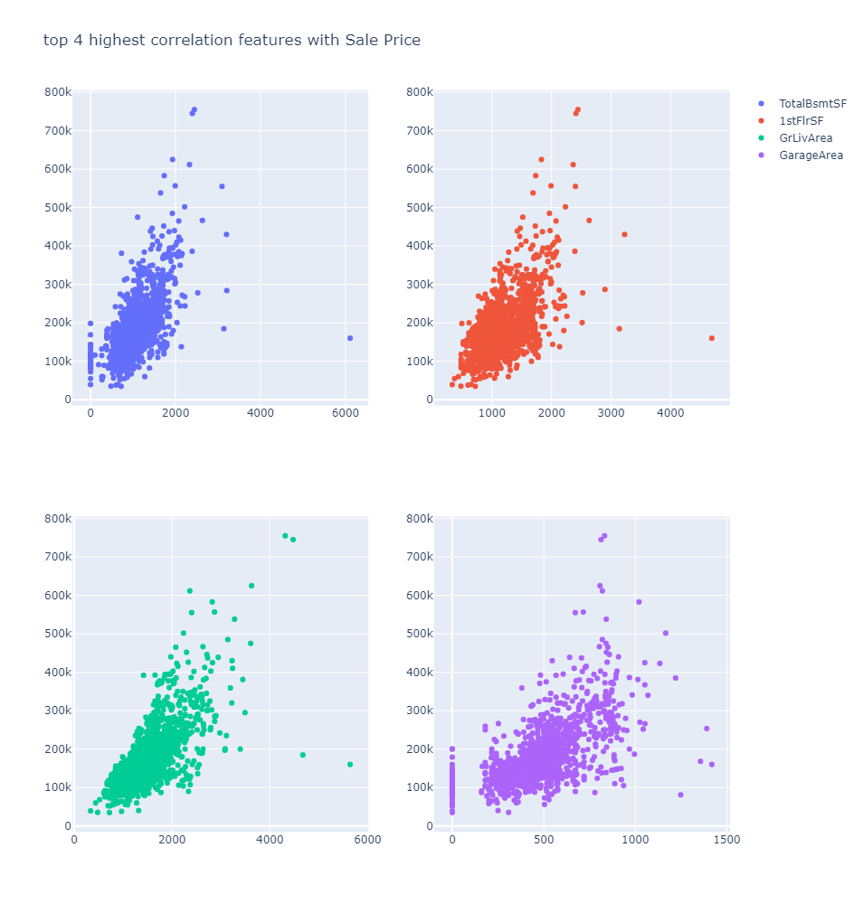
Top 4 highest correlation with sale price
'TotalBsmtSF’
'1stFlrSF’
'GrLivArea’
'GarageArea’
Sale price
features

Slide 15
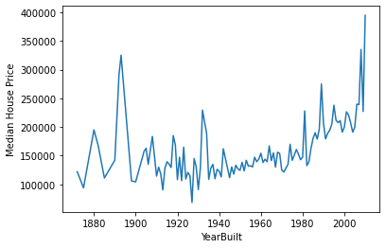
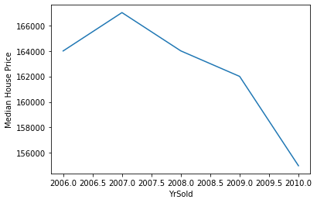
Year feature
Year House was Built vs Price of House
Year House was sold vs Price of House
Price of house inconsistent
Price of house drop

Slide 16
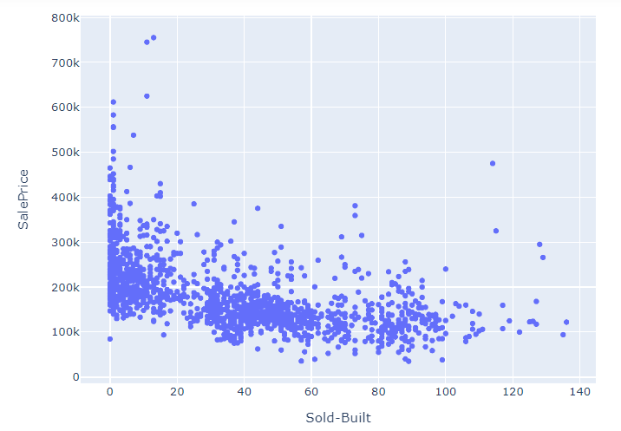
Feature Engineering
(YrSold – YrBuilt = Age of house)
The older the house, the lower the sale price

Slide 17
Machine Learning

Slide 18
Scaler – MinMaxScaler
Feature Selection - Ridge
Predictive Modelling
Linear Regression
Gradient Booster Regression
XGBoost Regression

Slide 19
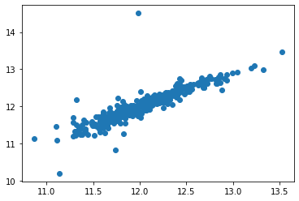
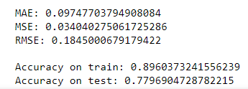
Linear Regression

Slide 20
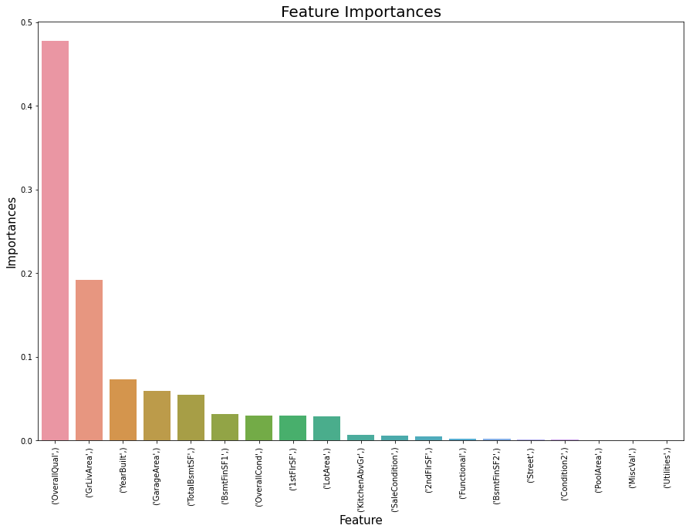
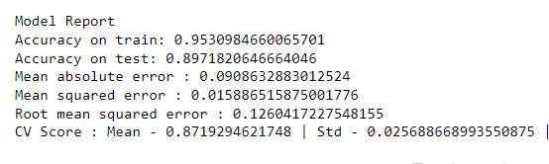
Gradient Boost Regression
Most important feature is ‘OverallQual’

Slide 21
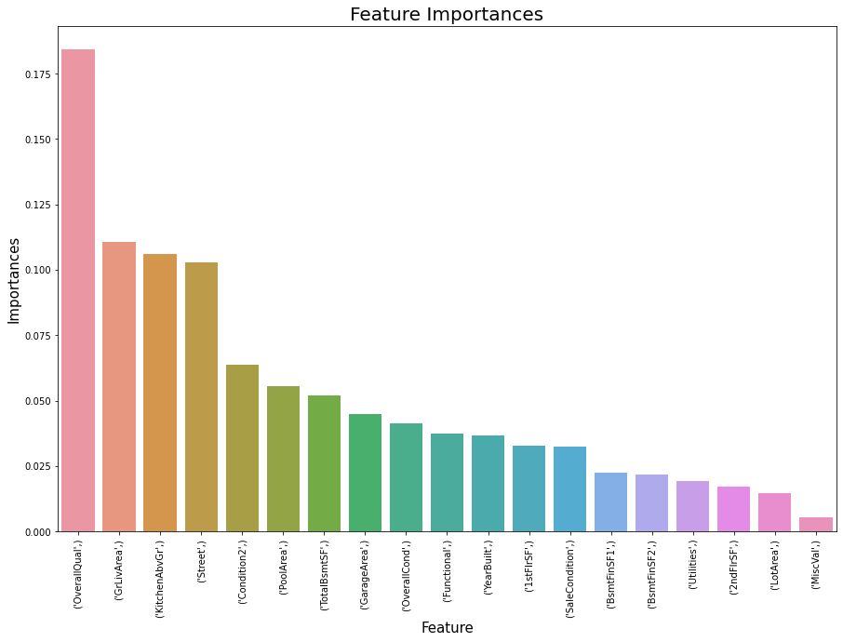
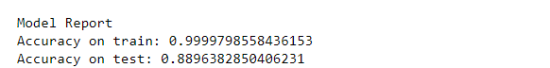
XGBoost Regression
Most important feature is ‘OverallQual’

Slide 22
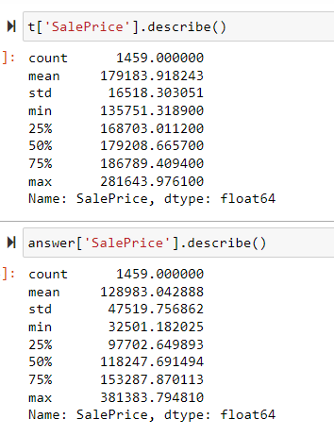
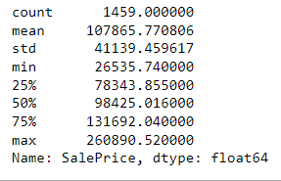
Test dataset
Gradient Booster Regression
XGBoost Regression
Mean, median and min of Gradient Booster is closer to test dataset compare to XGBoost.

Slide 23
Conclusion: Mean, median and minimum of Gradient Booster is closer to test dataset compare to XGBoost. We will choose prediction from Gradient Booster to be put in the solution
Accuracy On train dataset | Linear | Gradient Booster | XGBooster
Train | 0.89604 | 0.95310 | 0.99998
Test | 0.77969 | 0.89718 | 0.88964

Slide 24
Idea to improve for future analysis
Outlier removal
Attempt hyperparameter tuning to predict the best parameter
Choose different tools for feature selection

Slide 25



Libraries: machine learning - scikit learn mathematics - numpy dataframe - pandas visualization – seaborn, plotly, matplotlib References:

Slide 26
THANK YOU
Notes:
Log
Inverse log

